Slide 1
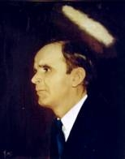
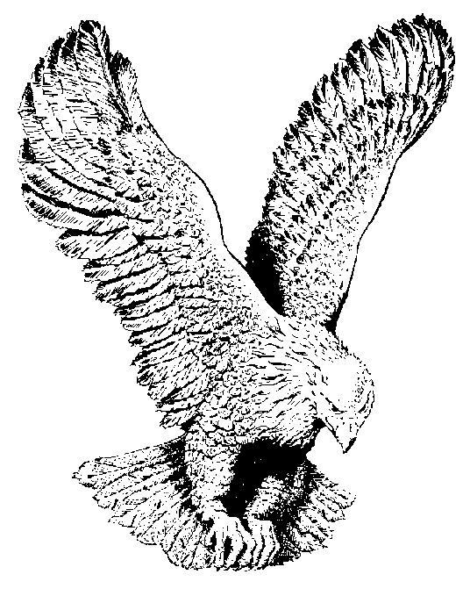
104
STAND ON THAT ROCK
Crying “Holy” unto the Lord,
Crying “Holy” unto the Lord,
If I could, I surely would
Stand on that rock where Moses stood.

